Slide 1

Chat Bot Via Python
(Machine & Deep Learning)

Slide 2
Index
Introduction
Main Components of Chatbot
Deep Learning for Chatbot
Conclusion

Slide 3
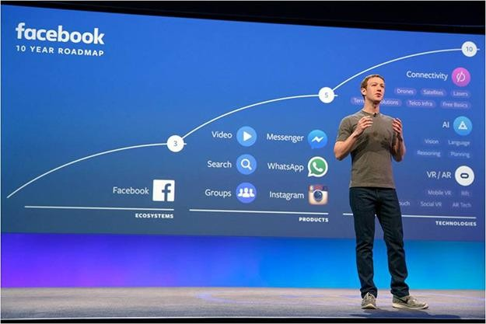
Introduction
Inspiration
“Facebook's future is in Chatbot”
2016.4, Mark Zuckerberg
The reaction is immediate.
Can communicate at the time I want.
Personalized conversations are possible.

Slide 4
Introduction
Inspiration (Individual opinion)
Data collection is relatively easy.
If necessary, data can be generated. (Dialogue Design .. but it’s difficult)
Various and a application domains

Slide 5

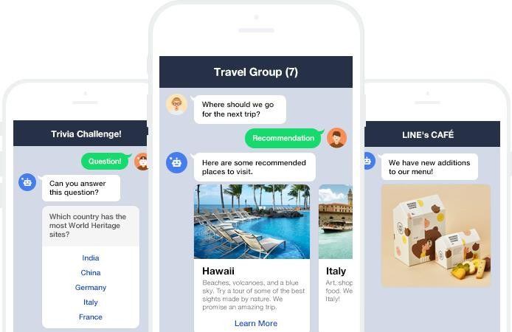
Introduction
What is Chatbot?
Chatbot = A computer program for chatting with a user

Slide 6
Introduction
What is Chatbot?
Chatbot = A computer program for chatting with a user
* 아래 3가지 모듈은 예시이며 모든 케이스를 포함하지 않음
User Interface
Answer Maker
User Interface
Input
Process
Output

Slide 7
Introduction
What is Chatbot?
Chatbot = A computer program for chatting with a user
* 아래 3가지 모듈은 예시이며 모든 케이스를 포함하지 않음
단편
상대방(유저)으로부터 입력을 받아들이는 부분
User Interface
간단한 명령어/키워드(#시작) 버튼(후보 답변 중 선택)
자연어(Natural Language Understanding)
Answer Maker User Interface
Process Output
풍부
Input

Slide 8
Introduction
What is Chatbot?
Chatbot = A computer program for chatting with a user
* 아래 3가지 모듈은 예시이며 모든 케이스를 포함하지 않음
단편
적절한 답변을 만들어내는 부분
목적
Rule based Retrieval Inference
Answer Maker
Closed Domain(Goal based) Open Domain(General Bot)
User Interface
Input
User Interface
풍부
Process
Output

Slide 9
Introduction
What is Chatbot?
Chatbot = A computer program for chatting with a user
* 아래 3가지 모듈은 예시이며 모든 케이스를 포함하지 않음
단편
답변을 유저가 보기에 적절한 형태로 가공하여 전달
답변 검색(Database Retrieval) #심심이 템플릿(Entity/Information 끼워넣기) 자연어(Natural Language Generation)
User Interface Answer Maker
Input Process
User Interface
풍부
Output

Slide 10
Introduction
This type of chatbot
Natural Language Interface
Inference based Answer Maker (Closed domain)
자연어로 입력을 받아서
가장 적절한 답변을 추론한다

Slide 11
Main Components of Chatbot
Identify the other party's intentions(Intent)
Identify the object in the other person's speech(Entity)
Input in natural language and deduce the most appropriate answer.
Consider context of conversation (Context)
Infer the answer(inference)

Slide 12

Chat bot

Slide 13
pip intall -r
requirements.txt
###rasa_core
apscheduler==3.3.1
fakeredis==0.8.2
graphviz==0.7.1
h5py==2.7.0
jsonpickle==0.9.4
keras==2.0.8
pandoc==1.0.0b2
redis==2.10.5
tensorflow
networkx==1.11
fbmessenger==4.3.1
ConfigArgParse==0.12.0
pykwalify==1.6.0
coloredlogs==7.3
ruamel.yaml==0.15.34
flask==0.12
rasa_nlu==0.11.4
###additional
pypandoc
slackclient
rasa_core==0.8.2
git+https://github.com/apixu/apixu-python.git
###rasa_nlu
gevent==1.2.1
Klein==17.2.0
boto3==1.4.4
typing==3.5.3.0
future==0.16.0
six==1.10.0
jsonschema==2.6.0
matplotlib==1.5.3
requests==2.14.2
tqdm==4.11.2
numpy==1.13.1
simplejson==3.11.1
### Sklearn
spacy==1.8.2
scikit-learn==0.19.1
sklearn-crfsuite==0.3.5

Slide 14
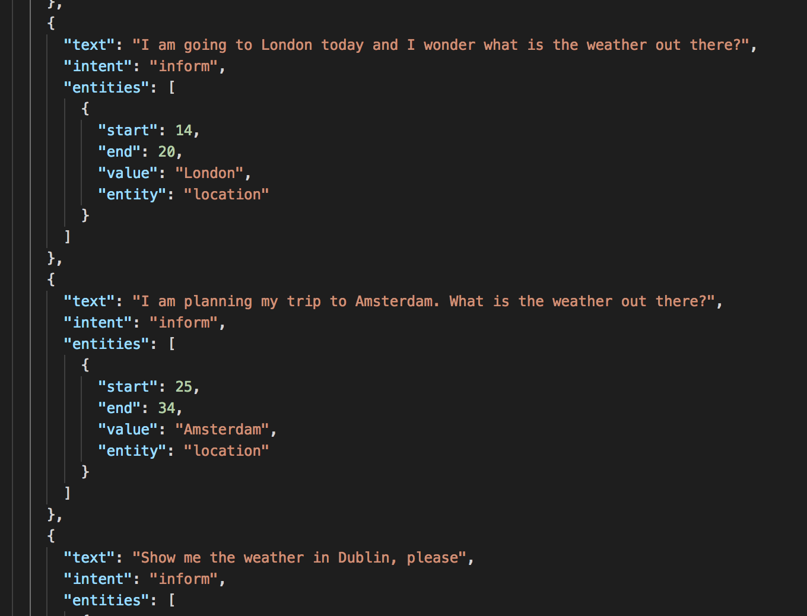
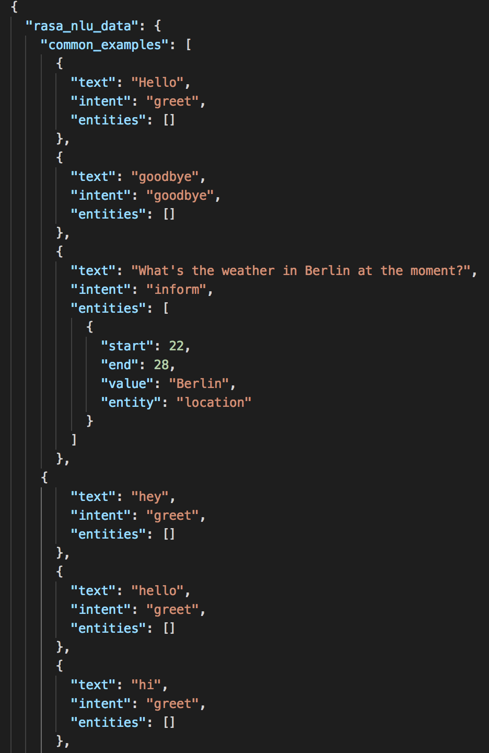
npm i -g
rasa-nlu-trainer
Make data.json
rasa-nlu-trainer

Slide 15
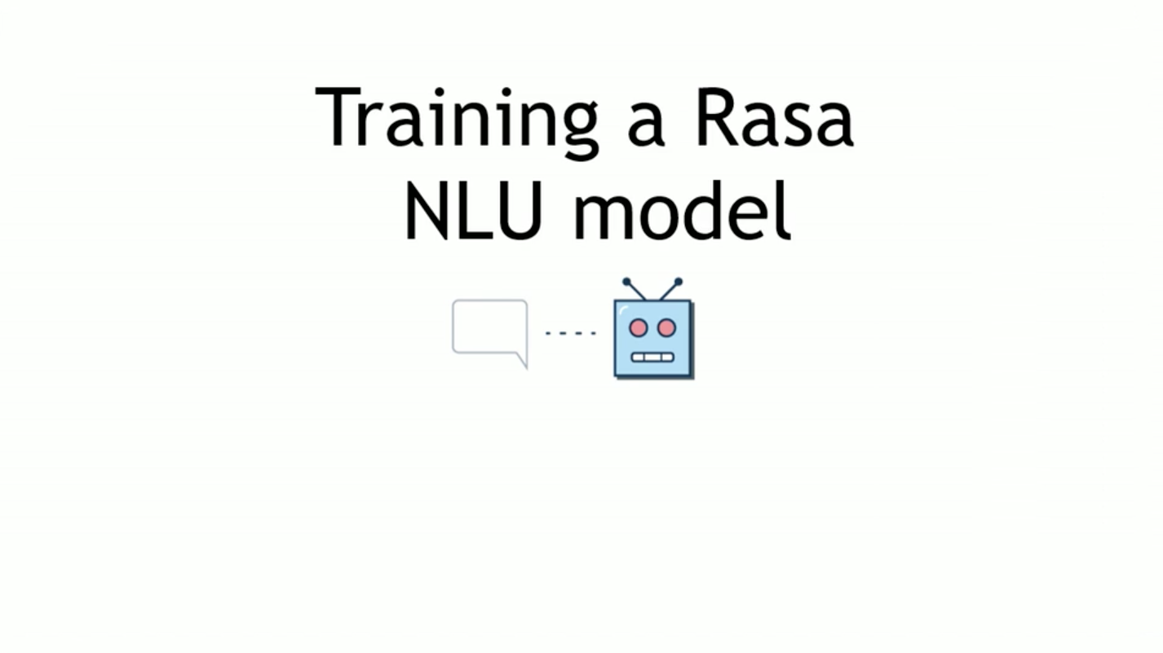

Slide 16
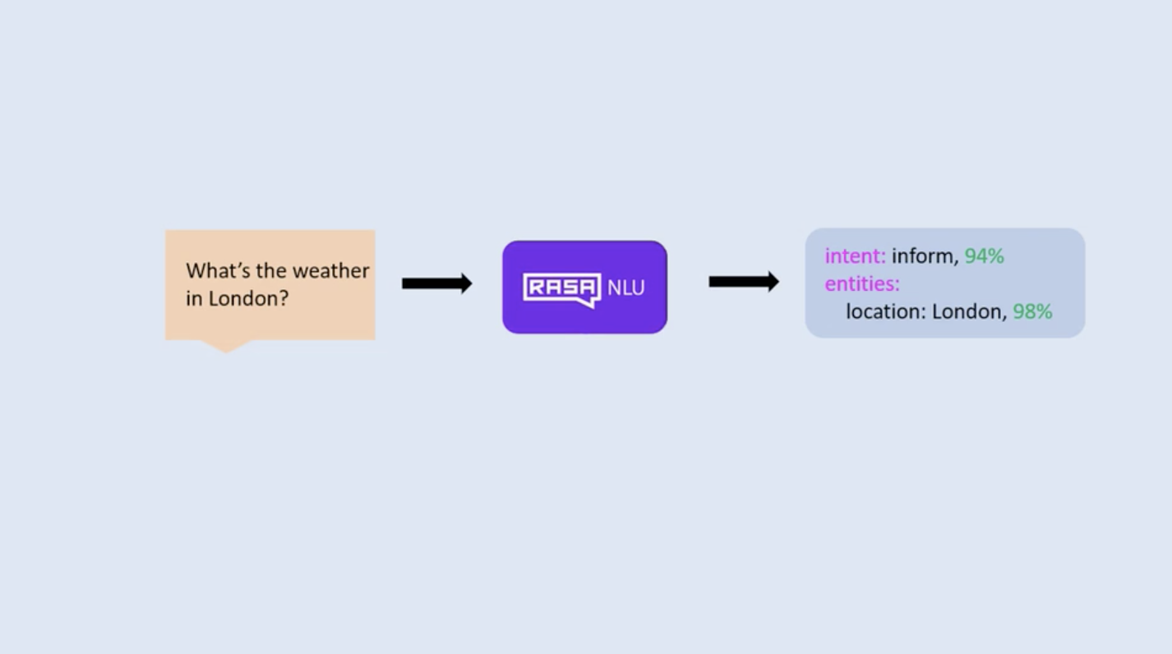

Slide 17
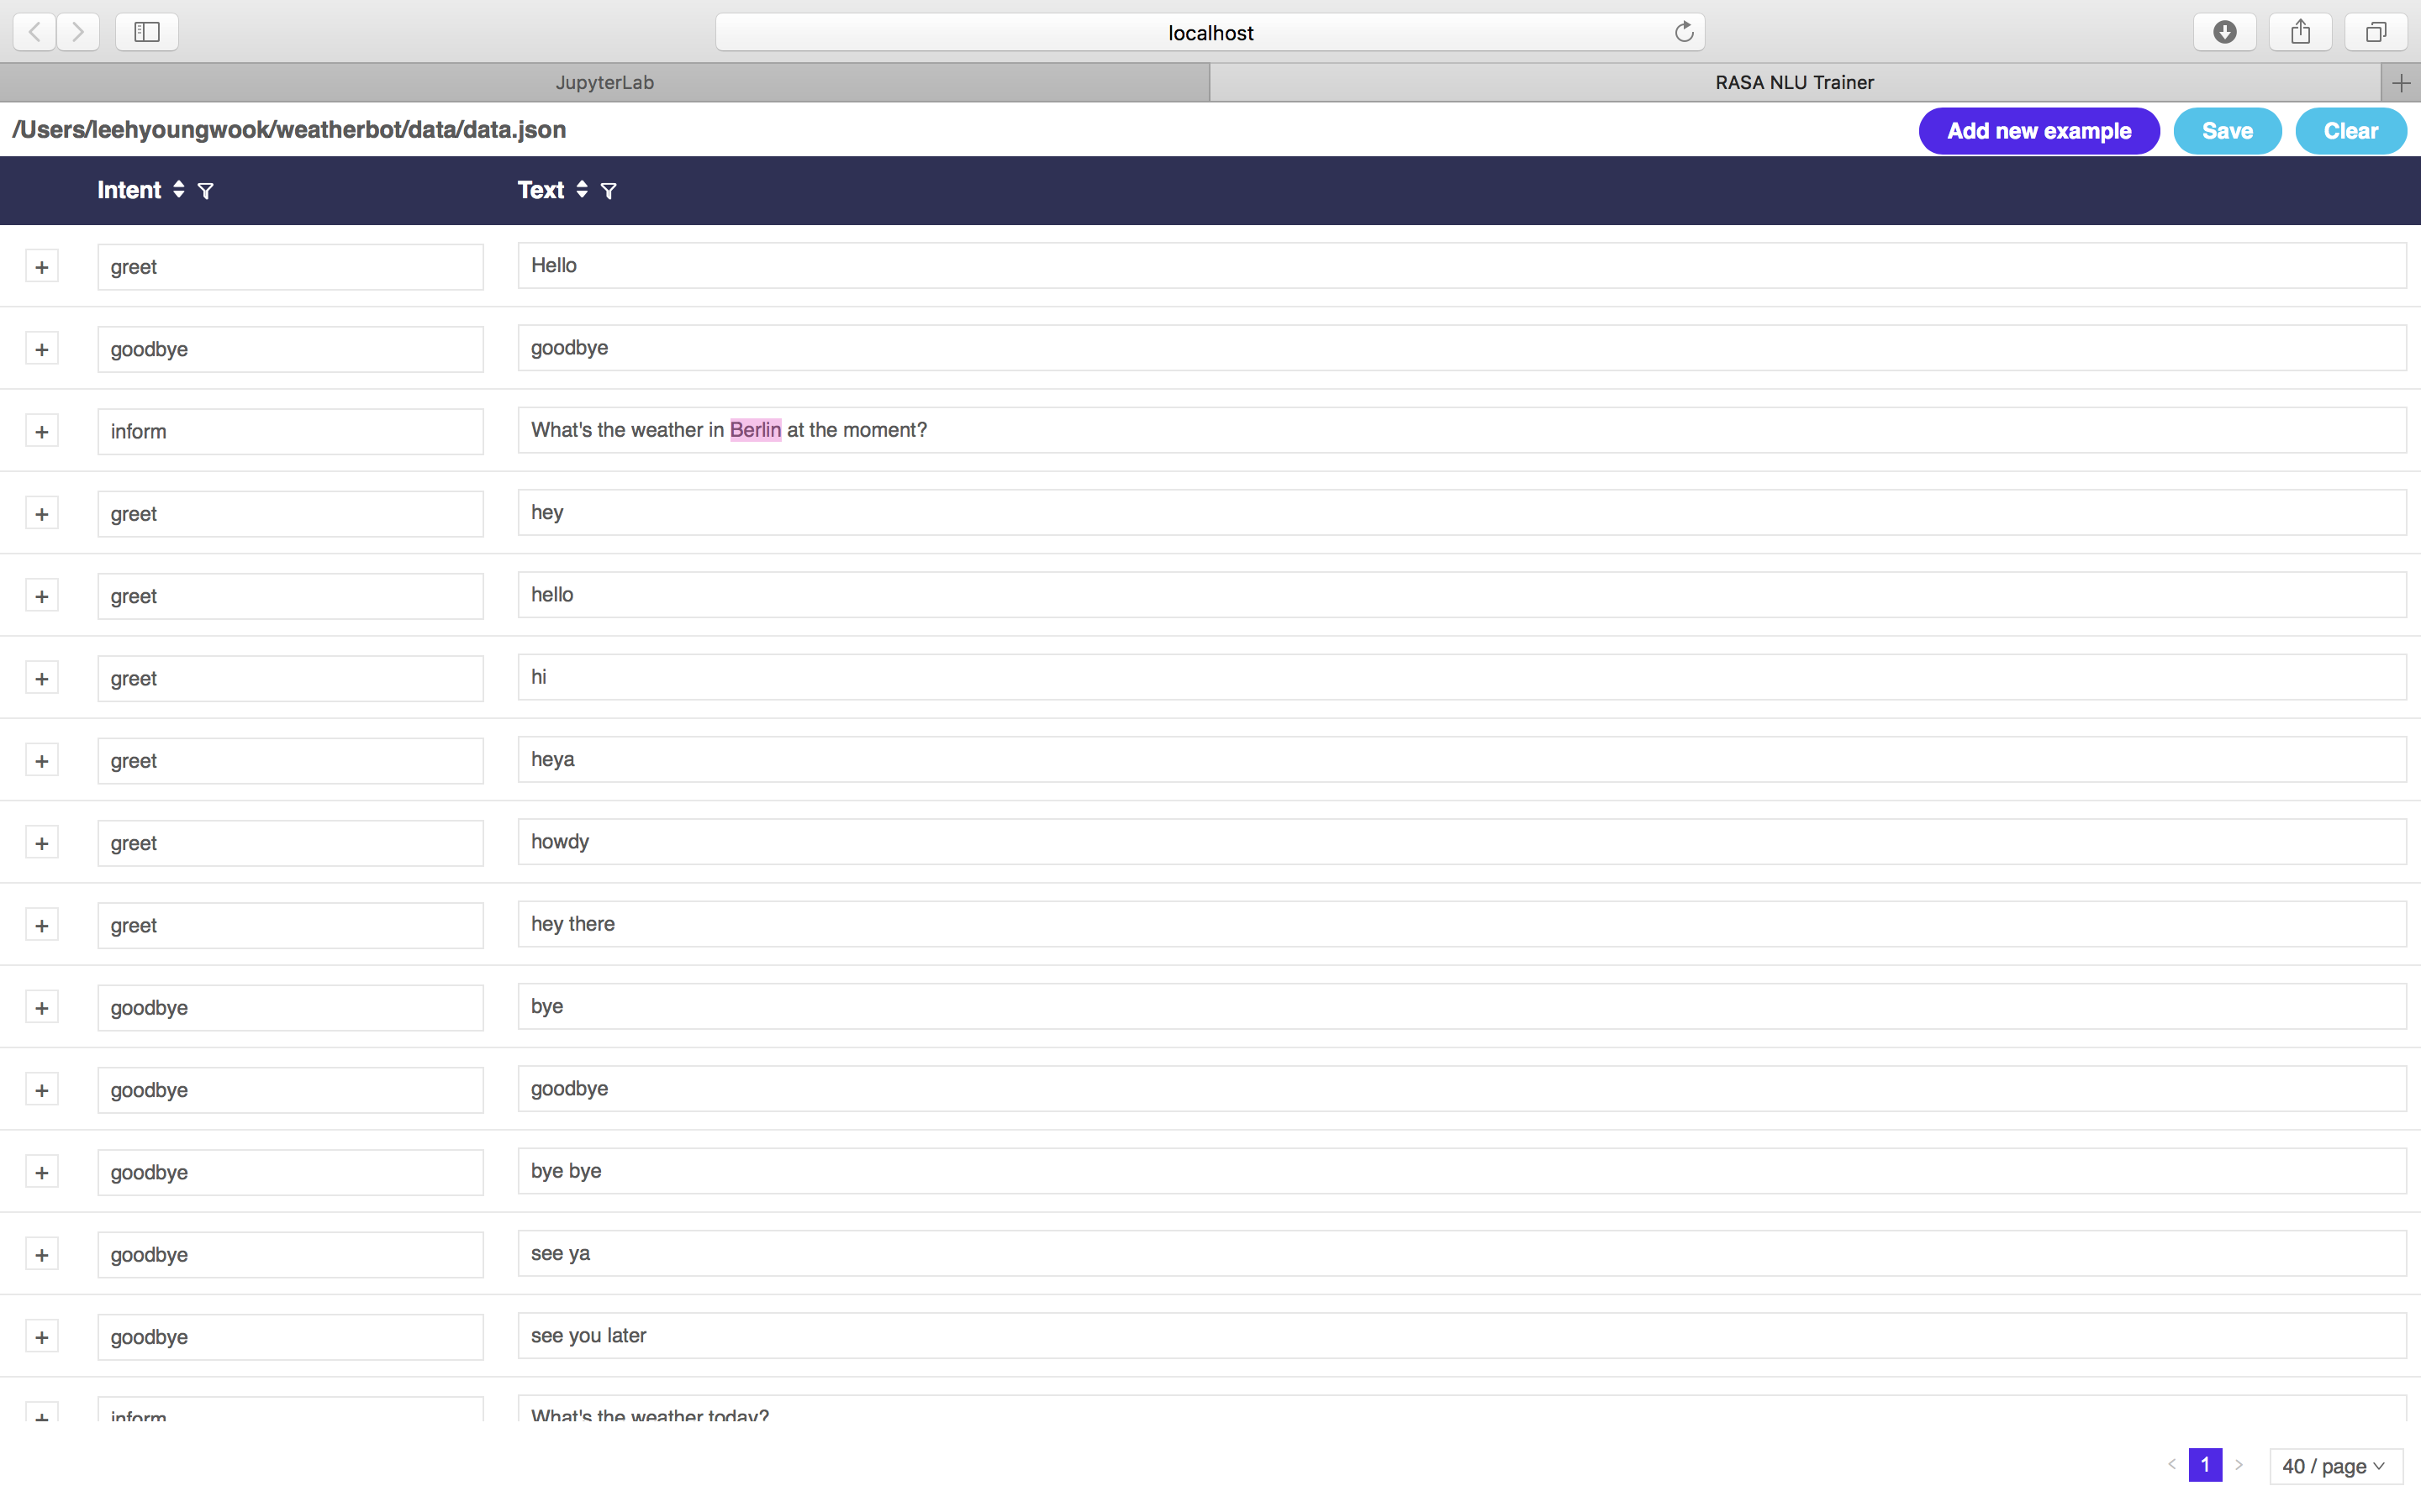

Slide 18
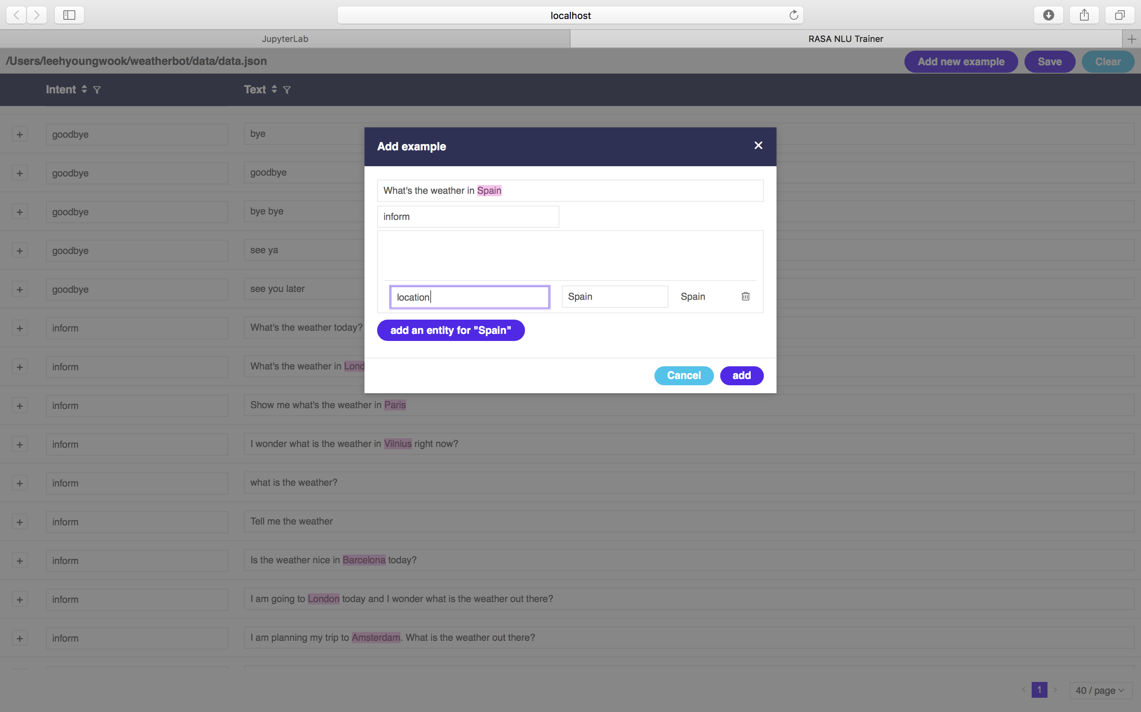

Slide 19

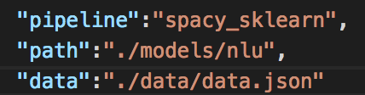

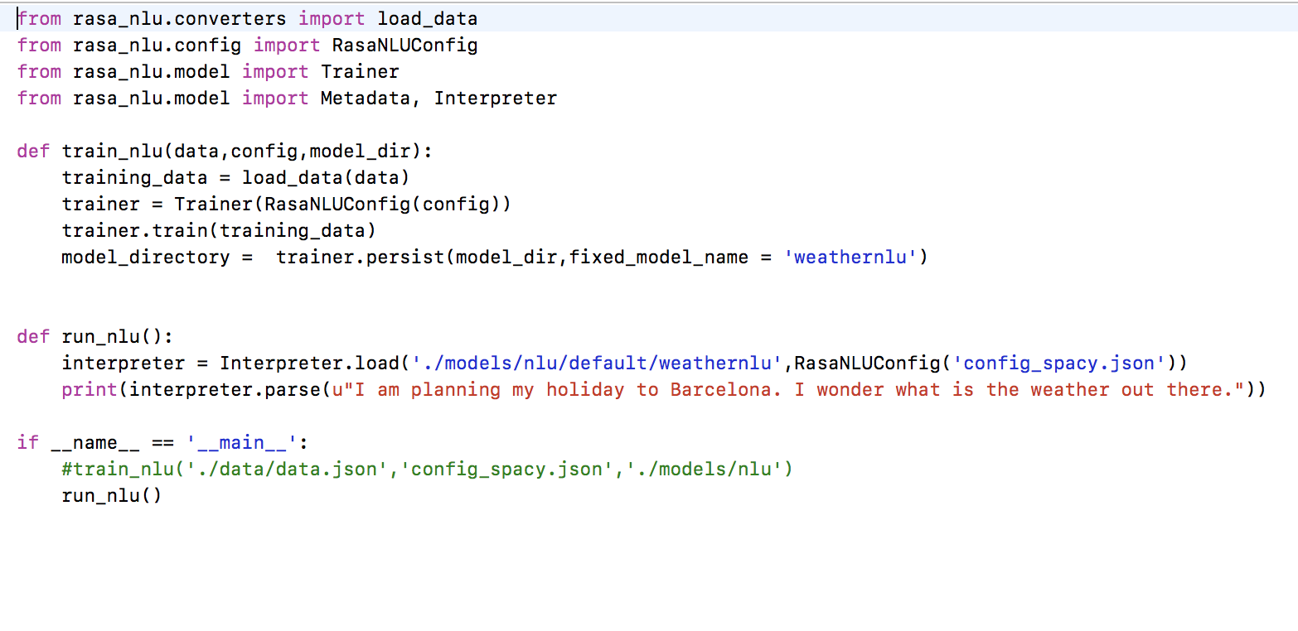
config_spacy.json
nlu_model.py

Slide 20

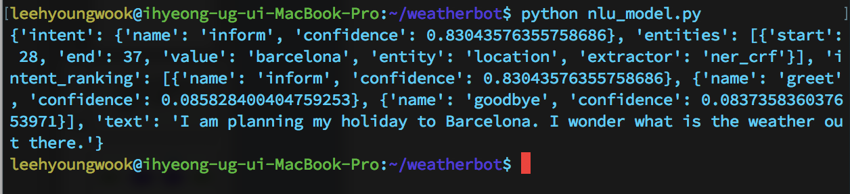
Python nlu_model.py
Check ! Confidence, intent, entities

Slide 21
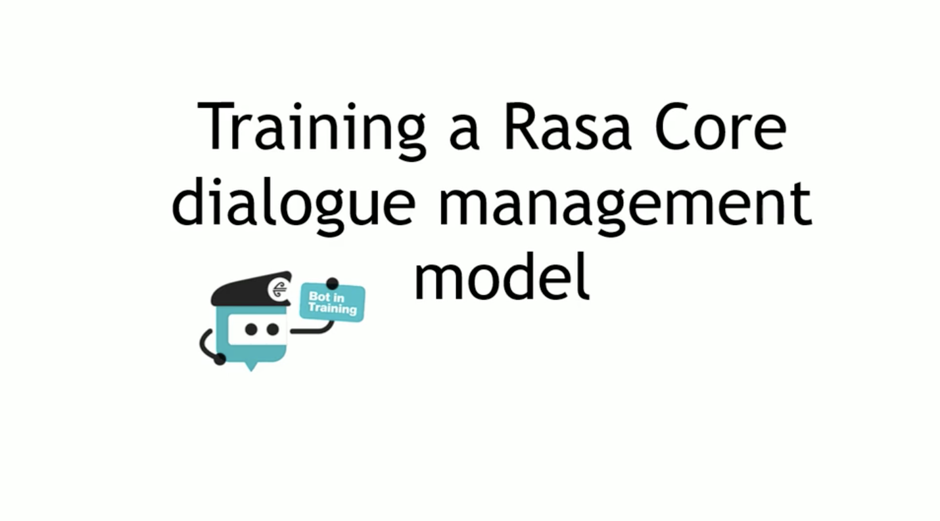

Slide 22
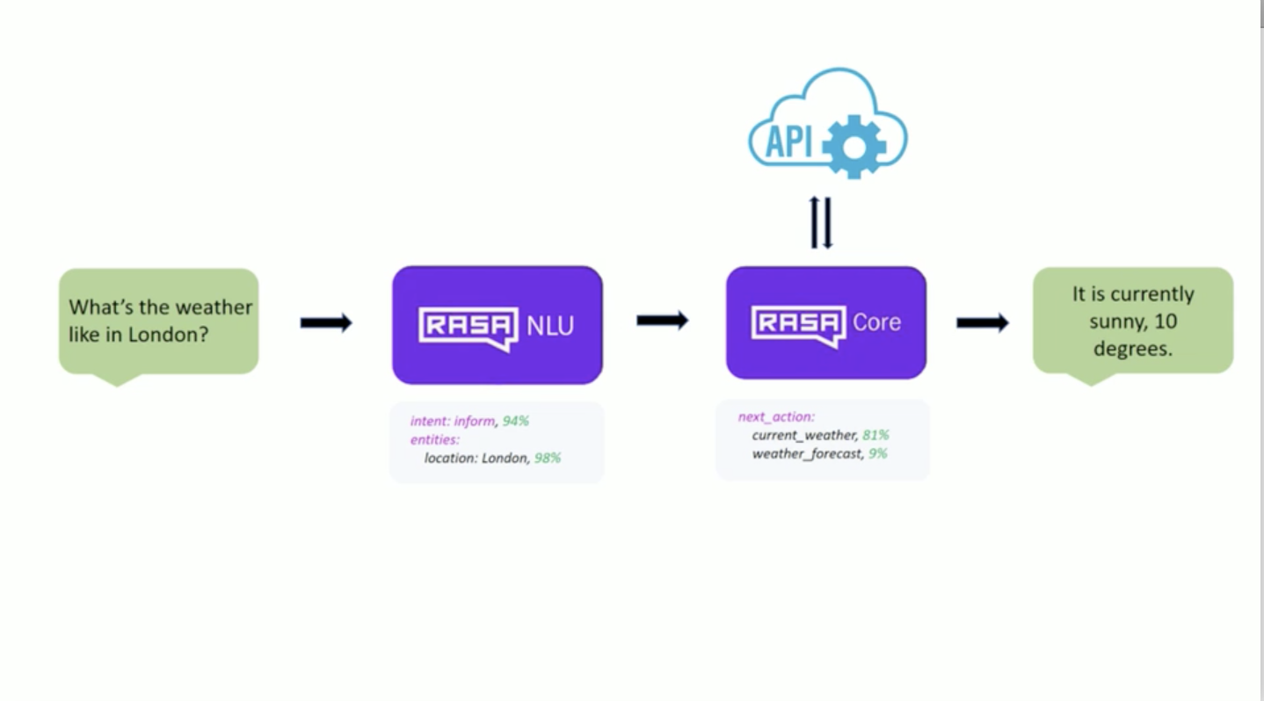

Slide 23
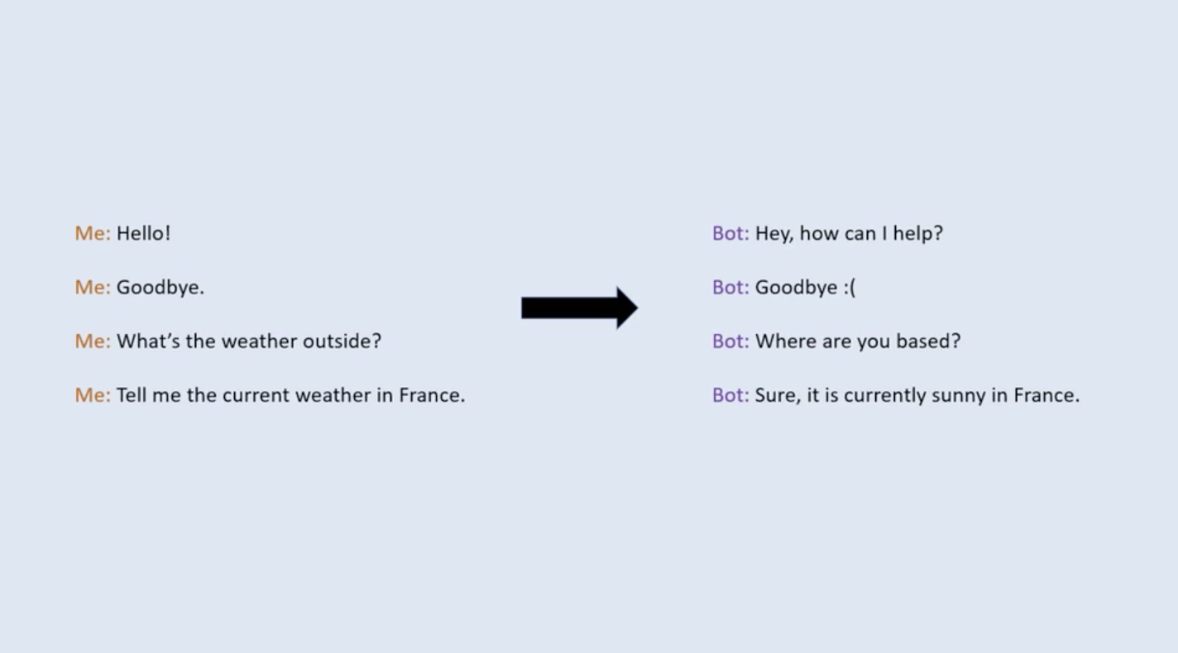

Slide 24

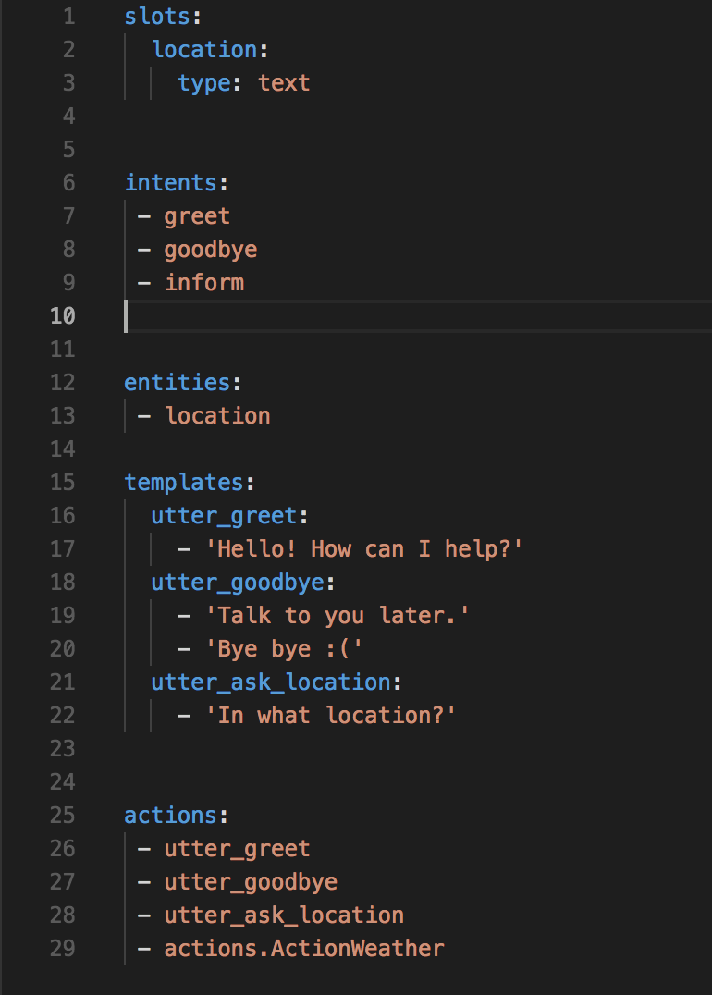
Create
weather_domain.yml

Slide 25
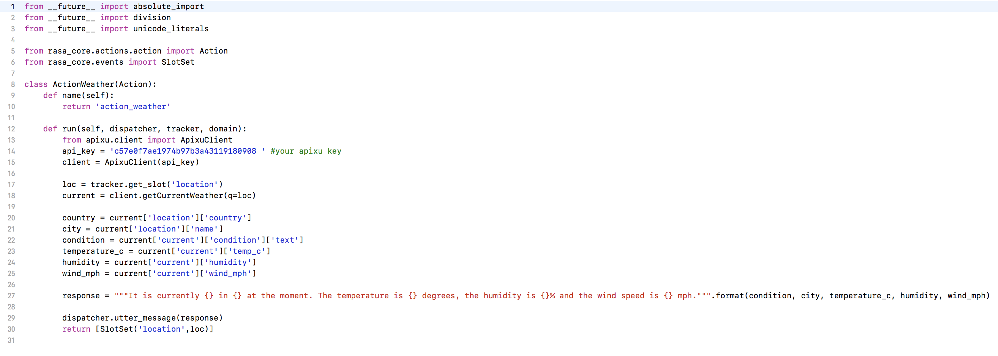
Create
actions.py
]
]
]
] weather.info
]
]
]

Slide 26
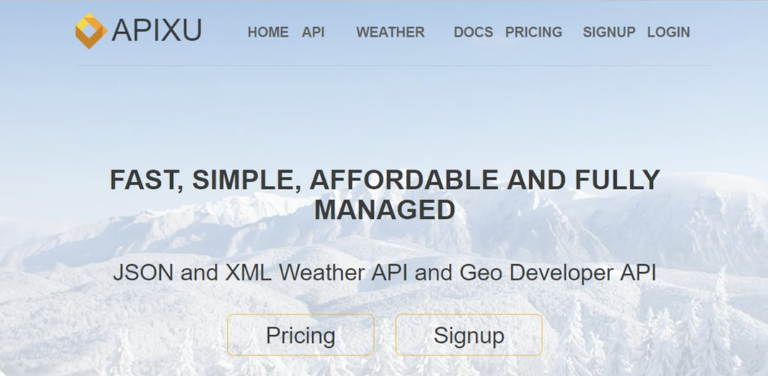
Bring Weather API

Slide 27
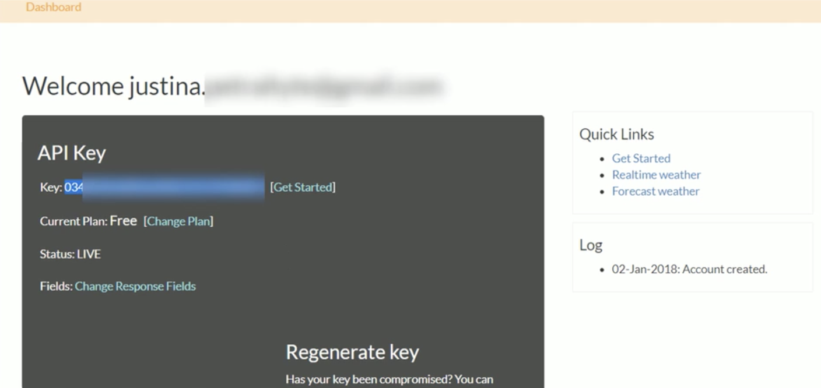

Slide 28
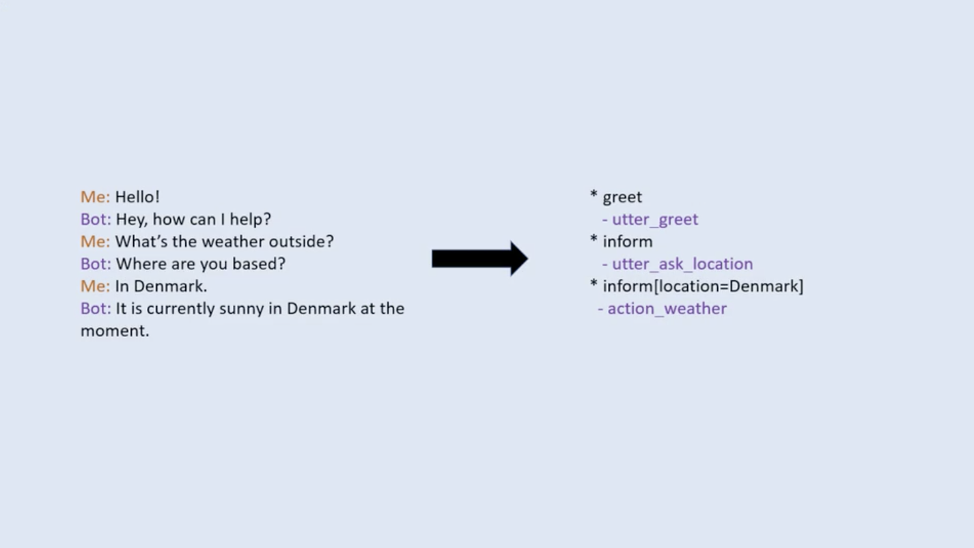

Slide 29

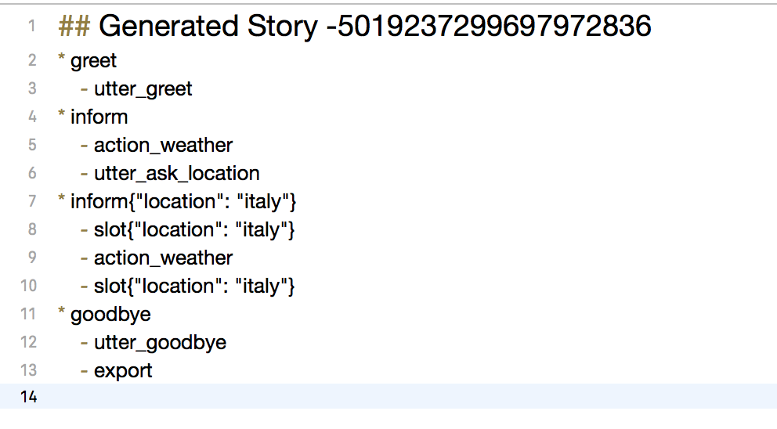
Create
stories.md

Slide 30
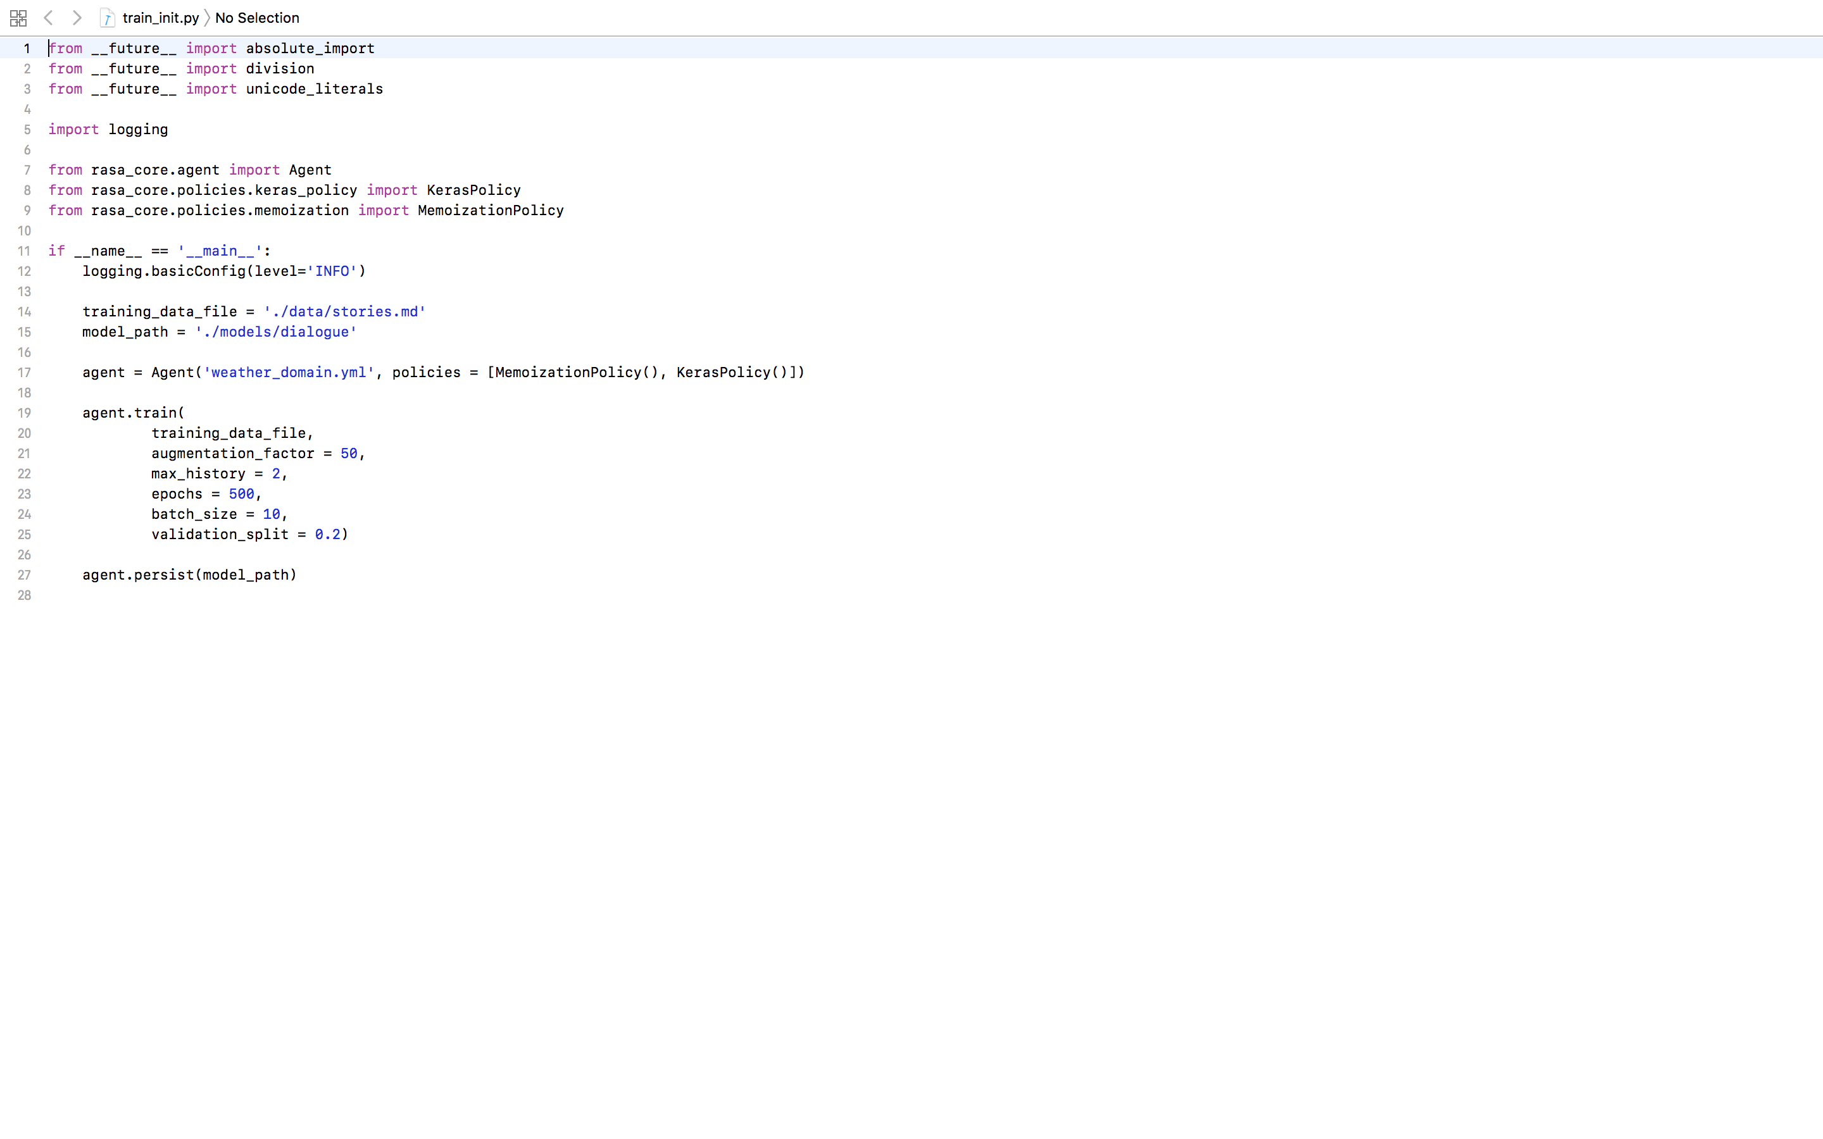
Create
train_init.py

Slide 31
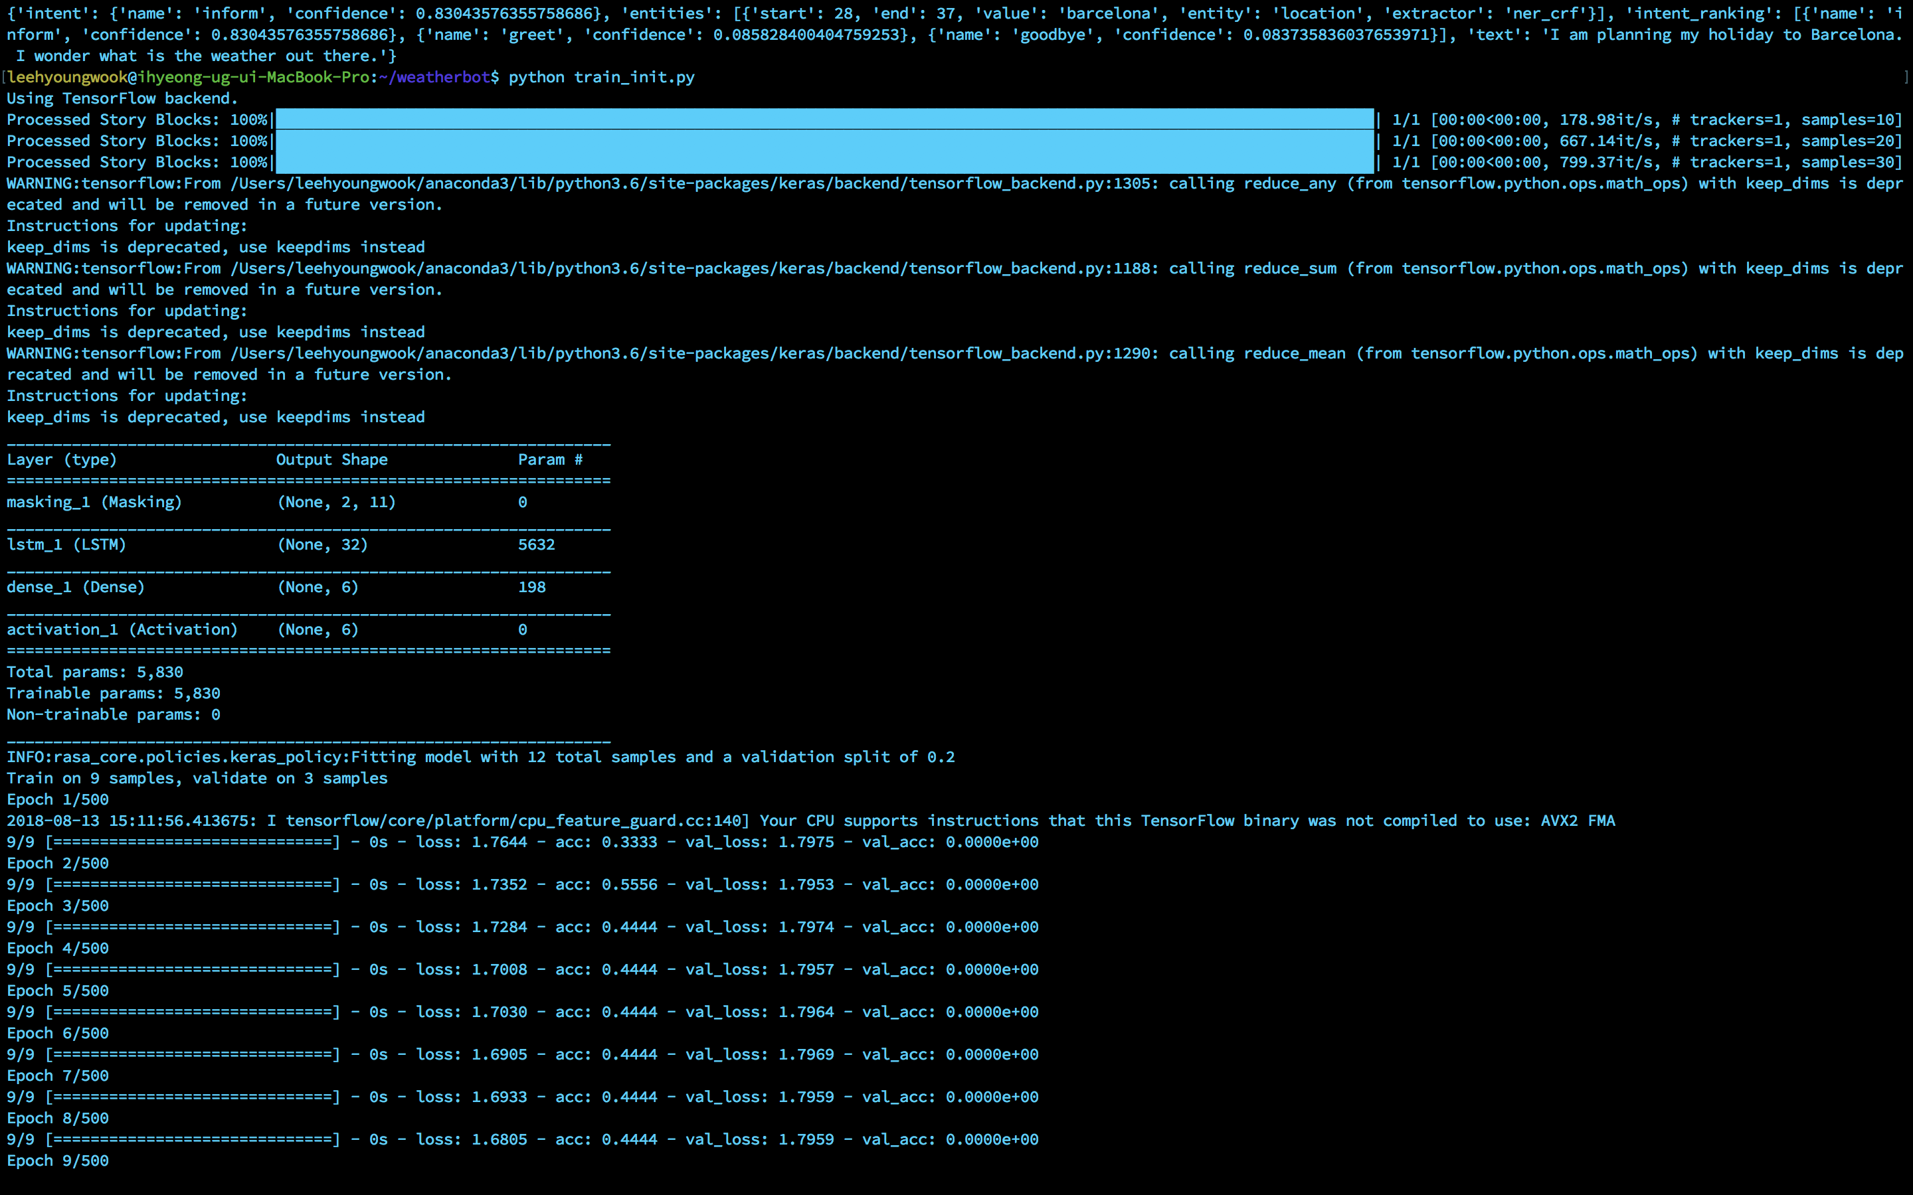
Python
train_init.py

Slide 32
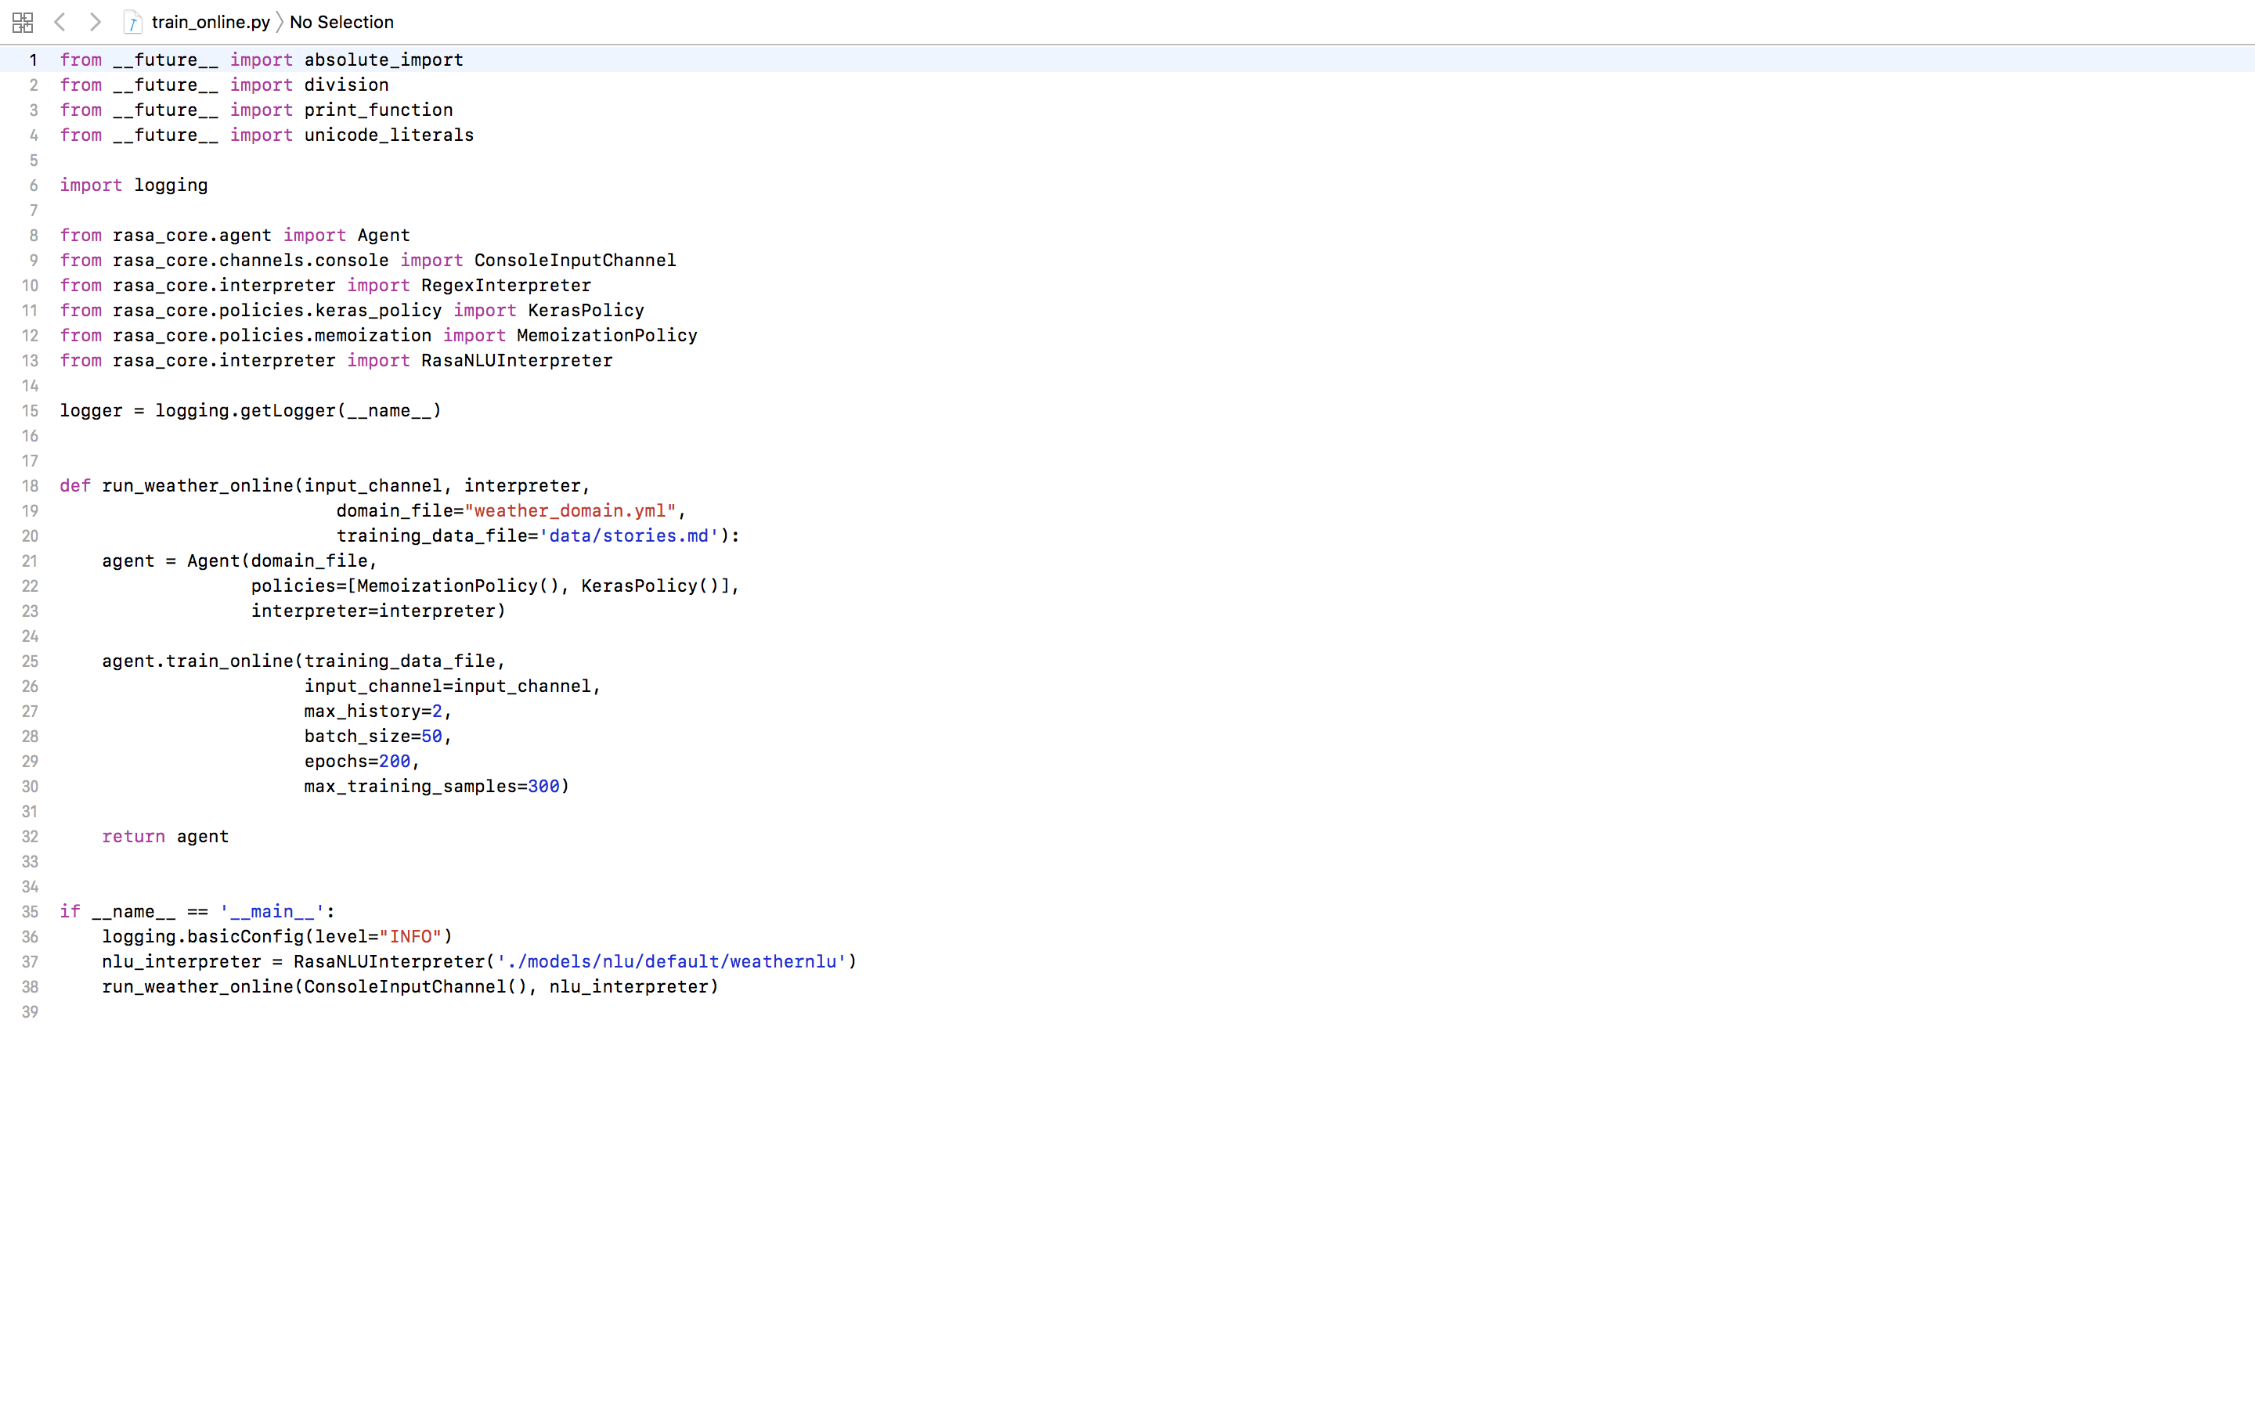
Create
train_online.py

Slide 33
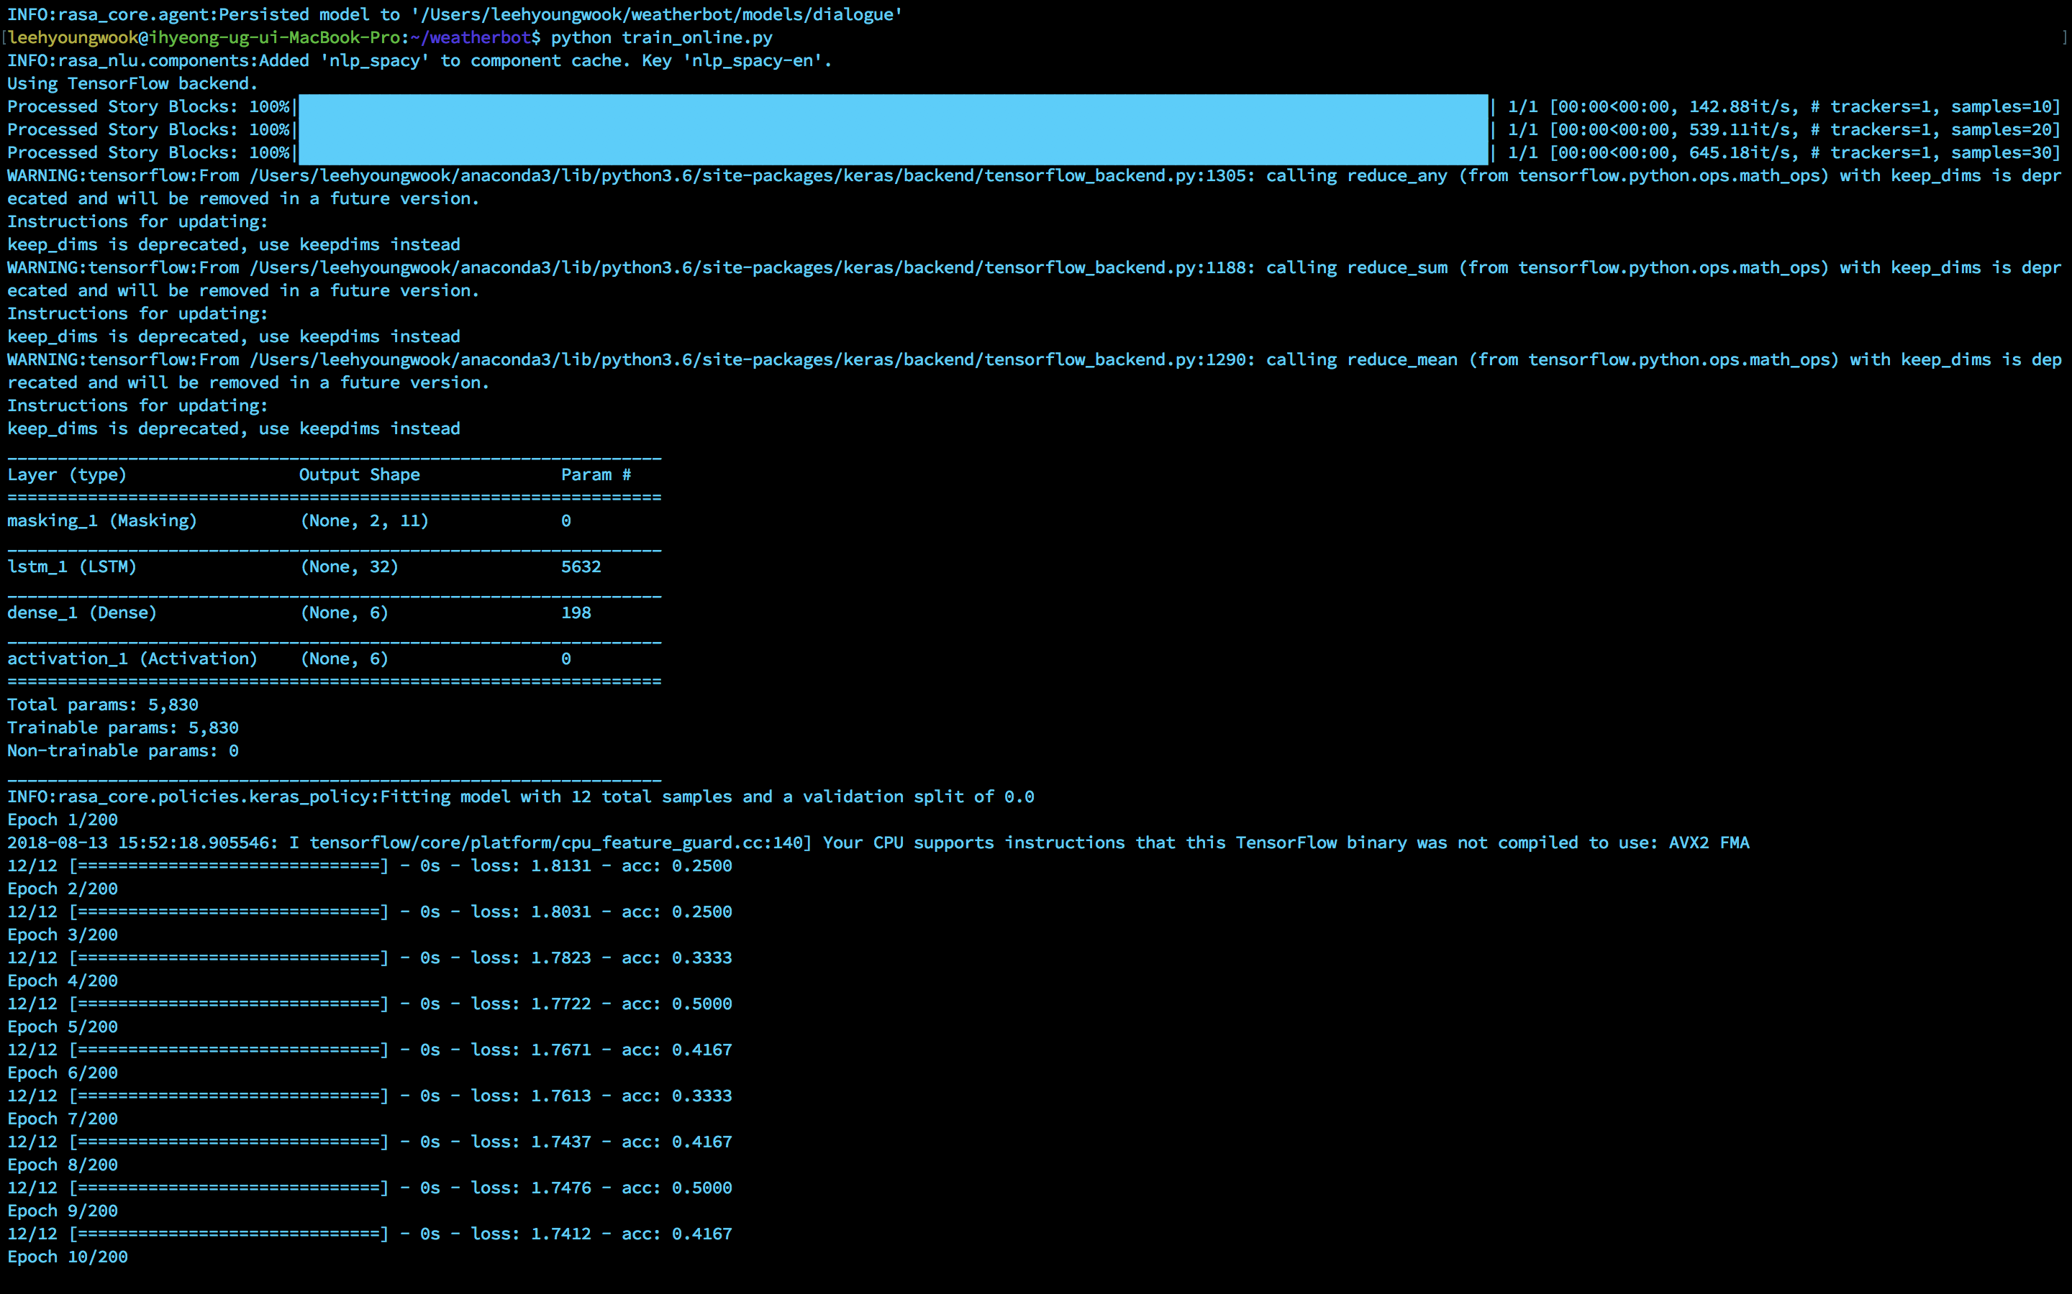
Python
train_online.py

Slide 34
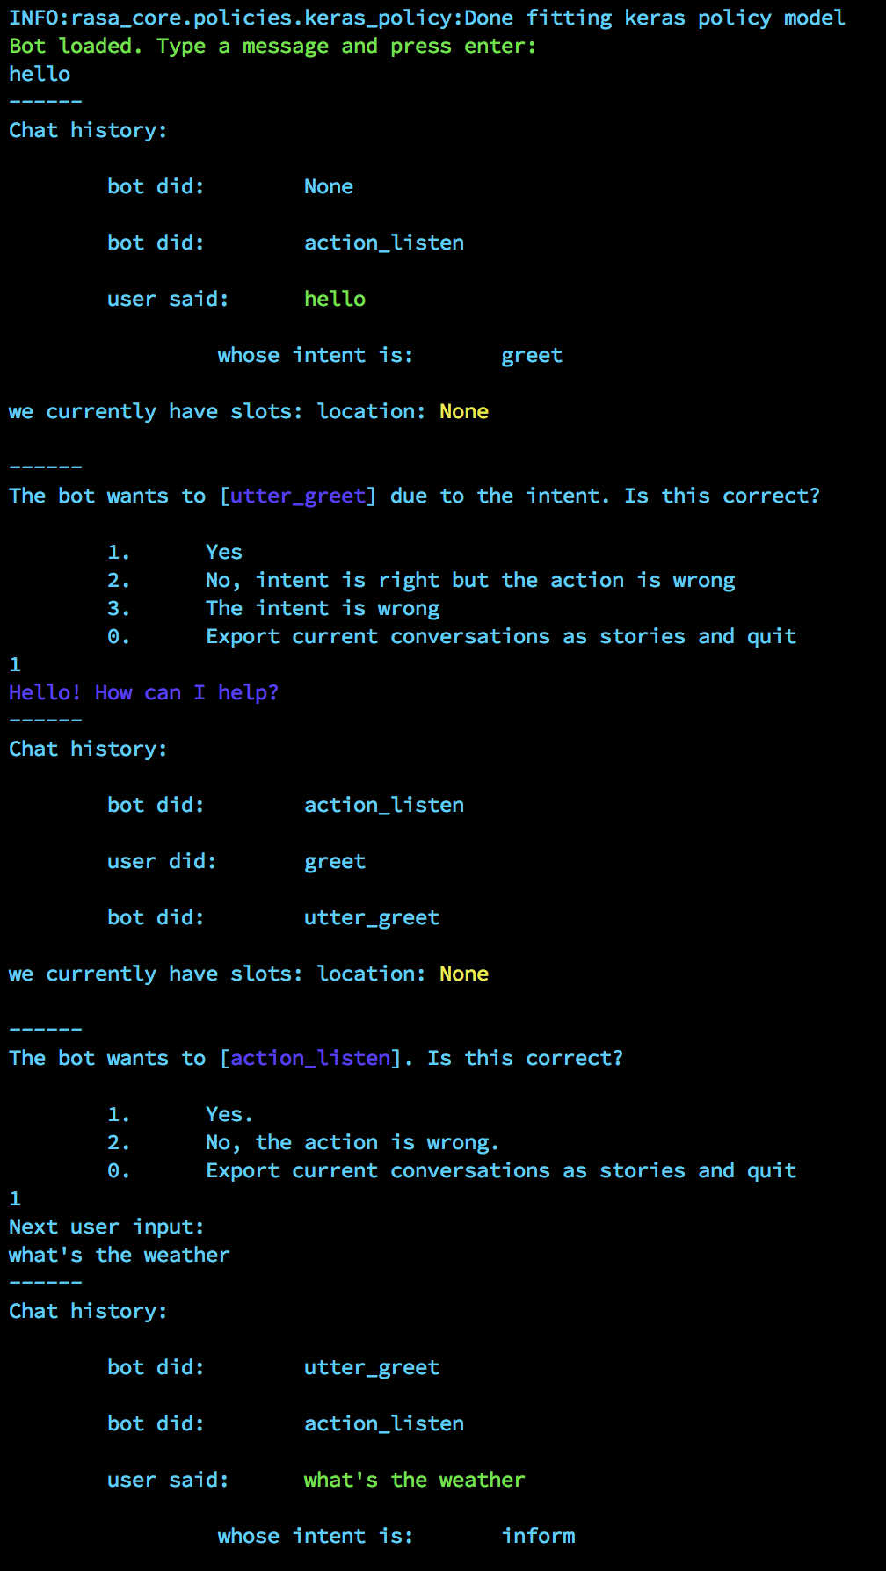
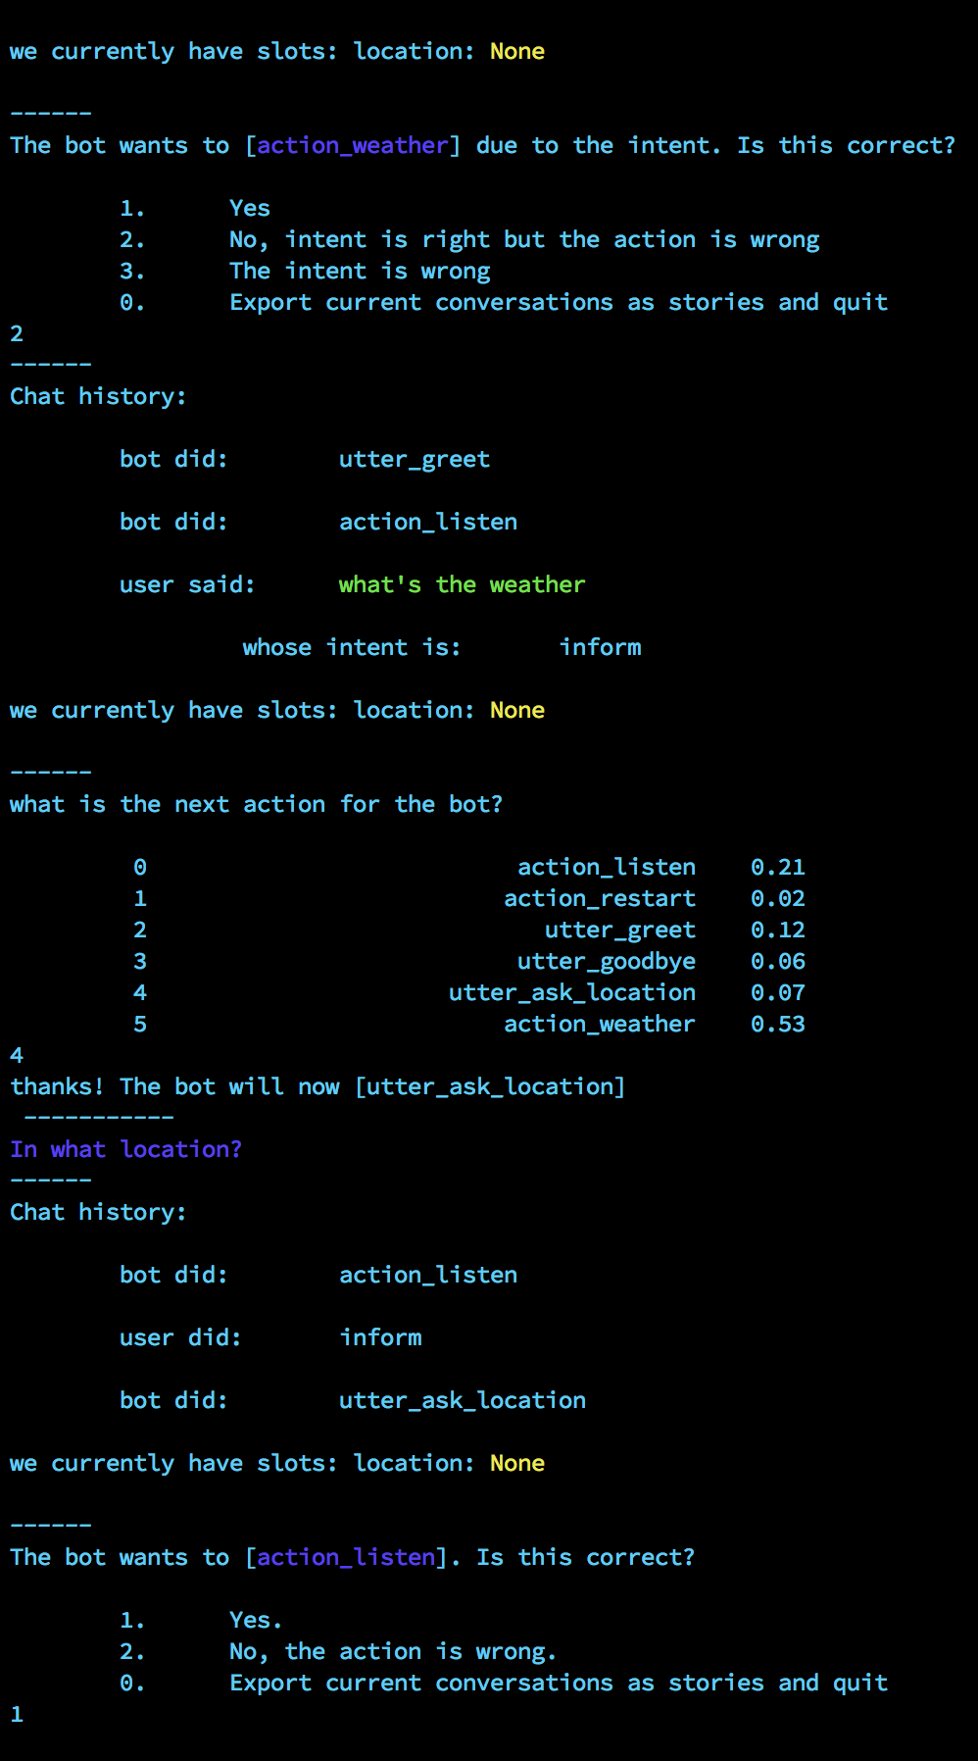
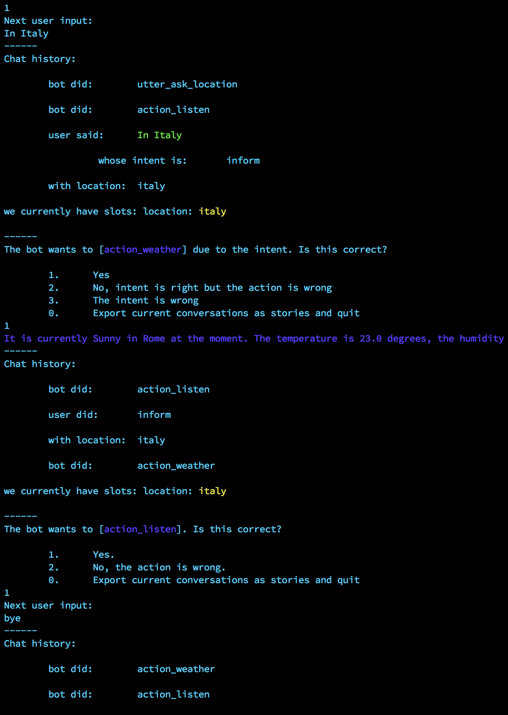
train_online.py

Slide 35
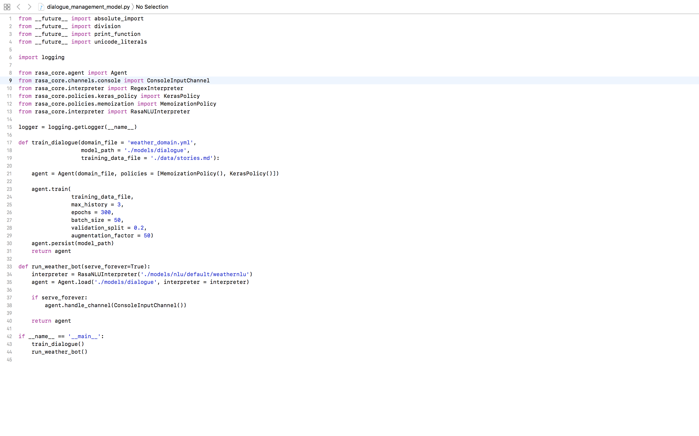
Create
dialogue_management_model.py

Slide 36
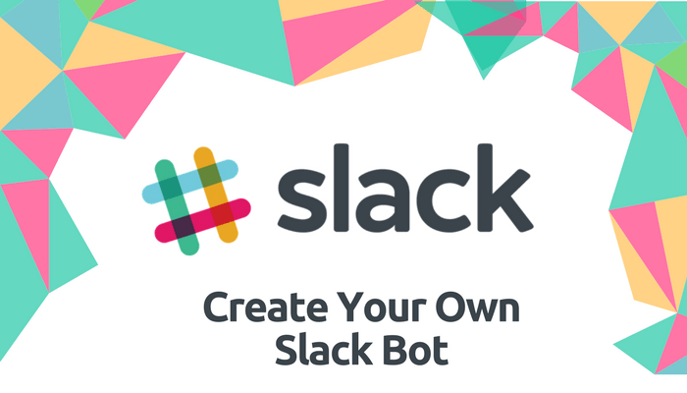

Slide 37
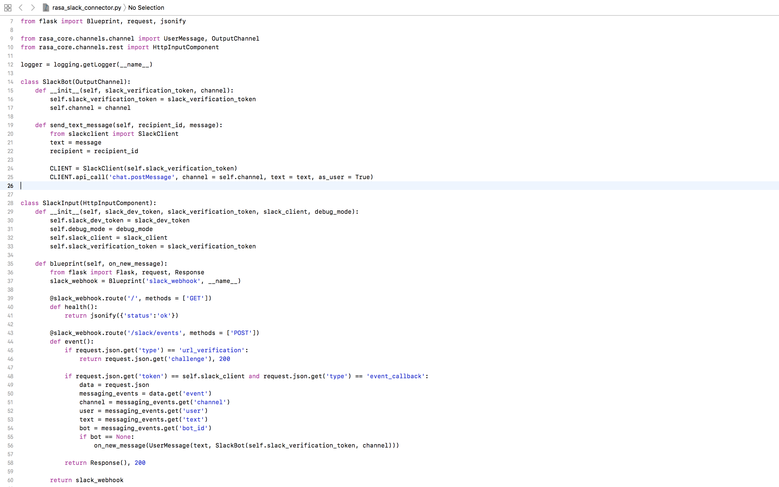
Create
rasa_slack_connector.py

Slide 38
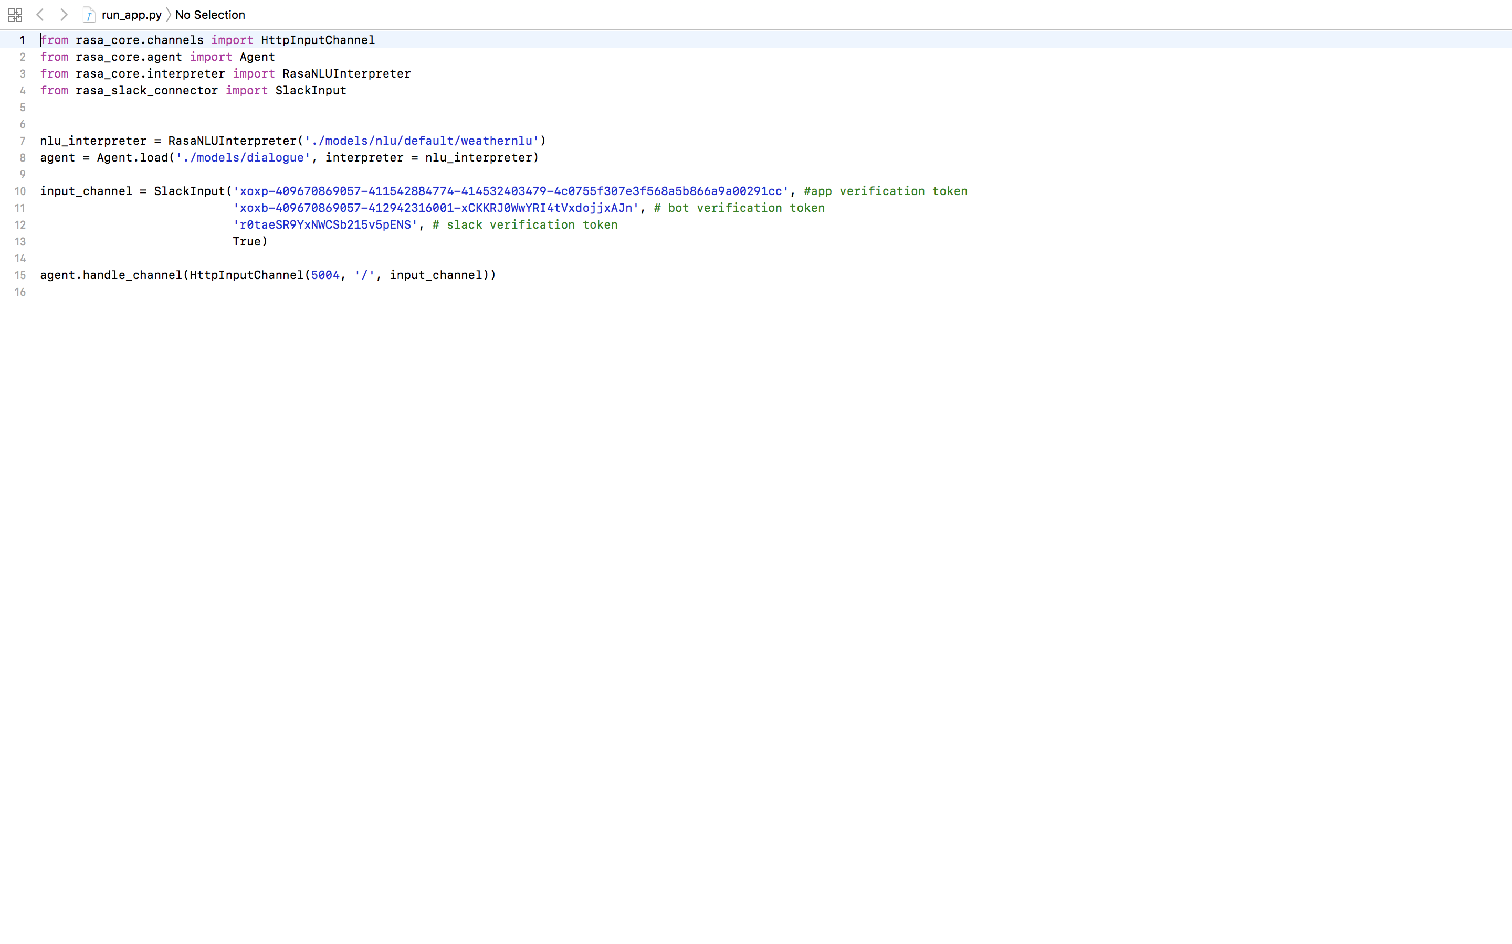
Create
run_app.py
] Slack App token,
bot Verification token,
Slack Verification token
] port Number

Slide 39

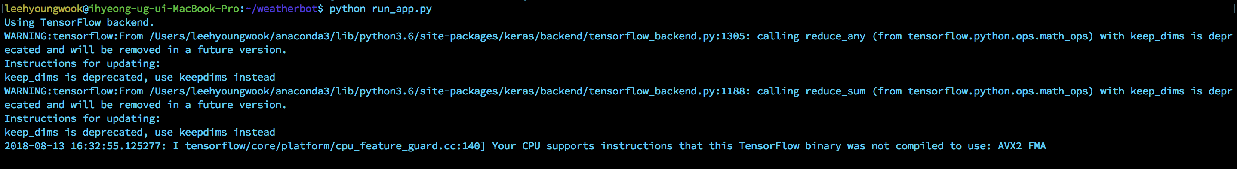


Run_app.py
Port Forwarding
(Access Localhost All Over Internet)

Slide 40

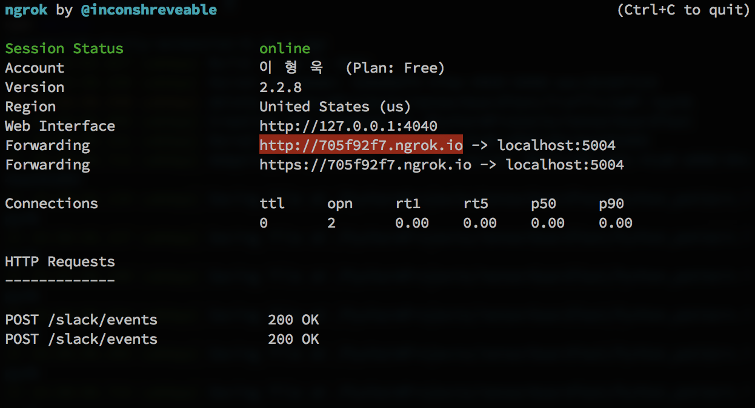
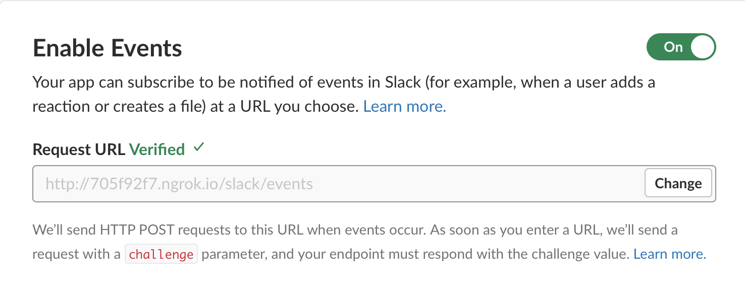
Bring localhost : ngrok
Enable Event :
Host Address

Slide 41
